Slide 1
Automating theme development
With Bootstrap & LESS
@kyletaylored
Levelten Interactive

Slide 2
The Drupal Theming Process
Get a design comp.
Choose a starting point
Base theme
Start from scratch
Write some code.
Delete that code.
Write more code.
Add some hooks.
Enter client review.
Go to step 3.

Slide 3
New project? Now do it all over again.

Slide 4
Theming in Drupal
The Bad
It’s hard.
It’s tedious.
It’s complicated.
The Good
Base themes are great.
Huge selection of contrib modules. (DS, Block Class, Fences, etc)
Separation of function and presentation.

Slide 5
Bootstrap & LESS
Bootstrap is the most popular HTML, CSS, and JS framework for developing responsive, mobile first projects on the web.
LESS is a dynamic stylesheet language that can be compiled into CSS and run on the client side or server side. (CSS Preprocessor).
TL;DR
Helps you quickly build decent looking websites.

Slide 6
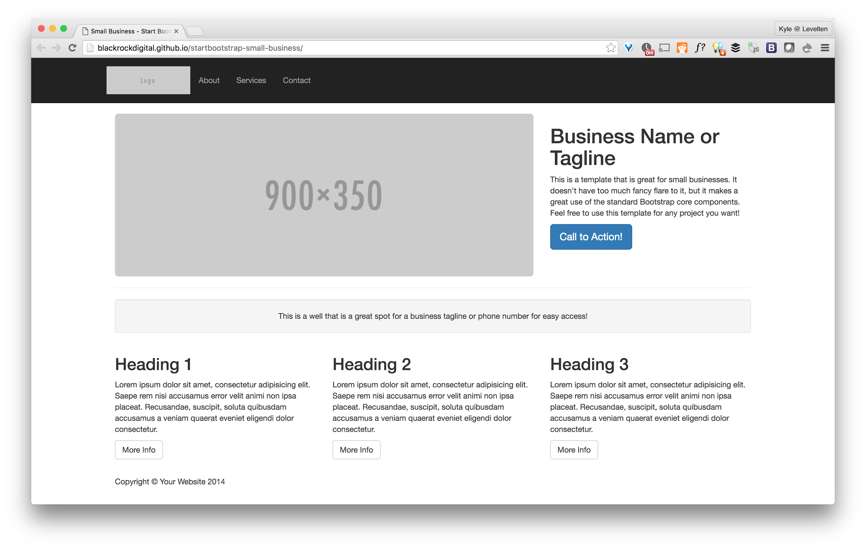

Slide 7
Why are we automating?
THEMES ARE HARD
Create dynamic themes without a lot of code.
Put as much (or as little) theming options in client hands.
Multi-brand? No problem. (case study)
Distributions.

Slide 8
But why Bootstrap?
Ubiquitous (lots of resources).
LESS compiles pretty fast.
Lots of contrib support. (LESSPHP, Drupal Bootstrap, CKEditor, etc)

Slide 9
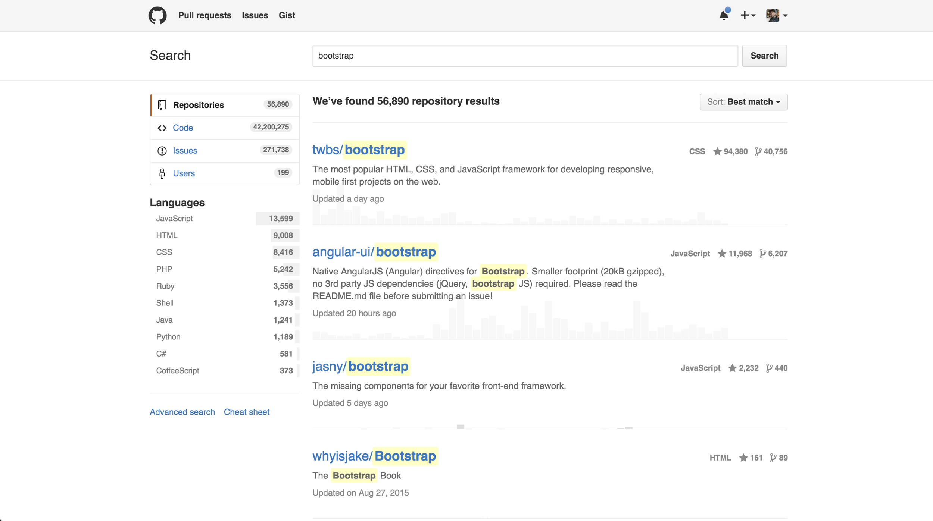

Slide 10
But Bootstrap 4 is in SASS...
Yea, well.

